Slide 1
Advanced Nanotechnology
(Nanoscience)
Optical
Electrical
Thermal
Magnetic
Top-down
Bottom-up
Properties of
Nanomaterials and structures

Slide 2
Magnetism to Spintronics
Dr. Shang-Fan Lee
Institute of Physics, Academia Sinica
Introduction to Solid State Physics
Kittel 8th ed
Chap. 11-13,
Solid State Physics
Ashcroft and Mermin
Chap. 31-33,
Condensed Matter Physics
Marder 2nd ed
Chap. 24-26,

Slide 3
Why do most broken permanent magnets repel each other?

Slide 4
Cooperative phenomena
Elementary excitations in solids describe the response of a solid to a perturbation
  Quasiparticles
  usually fermions, resemble the particles that make the system, e.g. quasi-electrons
  Collective excitations
  usually bosons, describe collective motions
  use second quantization with Fermi-Dirac or Bose- Einstein statistics

Slide 5
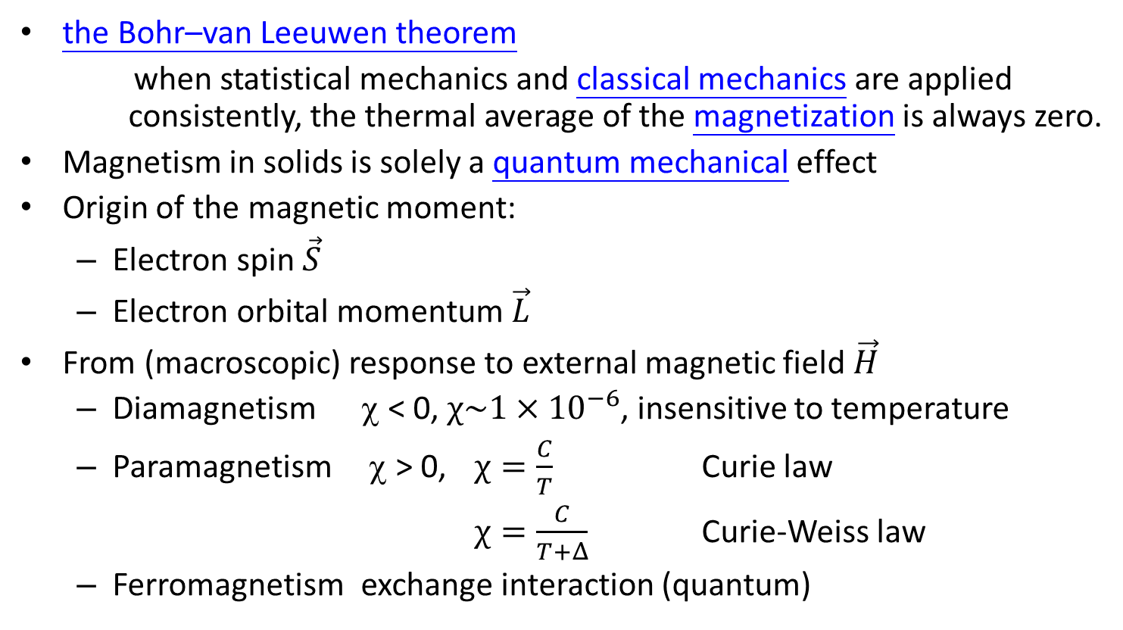
Magnetism
the Bohr–van Leeuwen theorem
when statistical mechanics and classical mechanics are applied consistently, the thermal average of the magnetization is always zero.
Magnetism in solids is solely a quantum mechanical effect
Origin of the magnetic moment:
  Electron spin $\vec{S}$
  Electron orbital momentum $\vec{L}$
From (macroscopic) response to external magnetic field $\vec{H}$
  Diamagnetism χ < 0, $χ\sim 1×{10}^{−6}$, insensitive to temperature
  Paramagnetism χ > 0, $χ=\frac{C}{T}$ Curie law
  $χ=\frac{C}{T+Δ}$ Curie-Weiss law
  Ferromagnetism exchange interaction (quantum)

Slide 6
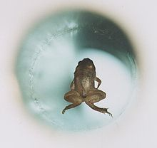
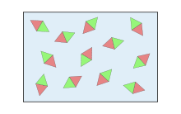
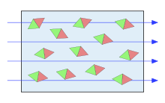
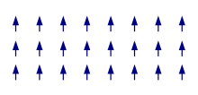
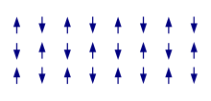
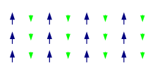
Magnetism
巨觀： 順磁性 逆磁性
Paramagnetism diamagnetism
微觀： 鐵磁性 反鐵磁性 亞鐵磁性
Ferromagnetism Antiferromagnetism Ferrimagnetism

Slide 7
Family Tree of Magnetism

Slide 8
Why do most broken permanent magnets repel each other?
N
N
N
S
N
?
S
S
S

Slide 9
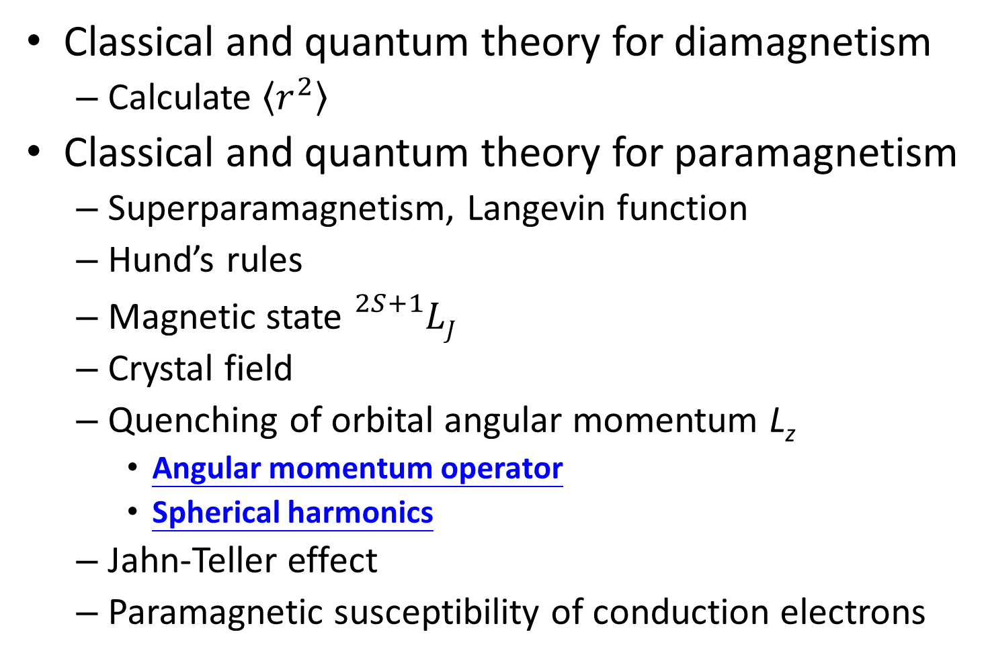
Classical and quantum theory for diamagnetism
  Calculate $\left\langle r^{2}\right\rangle$
Classical and quantum theory for paramagnetism
  Superparamagnetism, Langevin function
  Hund’s rules
  Magnetic state ${}_{}^{2S+1}{LJ}$
  Crystal field
  Quenching of orbital angular momentum L_{z}
    Angular momentum operator
    Spherical harmonics
  Jahn-Teller effect
  Paramagnetic susceptibility of conduction electrons

Slide 10
Ferromagnetism
  Microscopic – ferro, antiferro, ferri magnetism
  Exchange interaction
  Exchange splitting – source of magnetization
  two-electron system spin-independent Schrodinger equation
  Type of exchange: direct exchange, super exchange, indirect exchange, itinerant exchange
  Spin Hamiltonian and Heisenberg model
  Molecular-field (mean-field) approximation

Slide 11
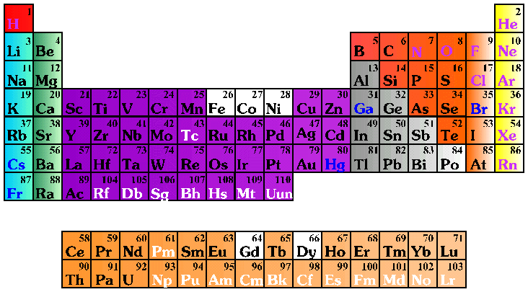
Ferromagnetic elements: 鐵 Fe, 鈷 Co, 鎳 Ni, 釓 Gd, 鏑 Dy,
錳 Mn, 鈀 Pd ??
Elements with ferromagnetic properties
合金, alloys
錳氧化物 MnOx, ……
Notes:
spin ferromagnet 指南車

Slide 12





Platonic solid From Wikipedia
In geometry, a Platonic solid is a convex polyhedron that is regular, in the sense of a regular polygon. Specifically, the faces of a Platonic solid are congruent regular polygons, with the same number of faces meeting at each vertex; thus, all its edges are congruent, as are its vertices and angles.
There are precisely five Platonic solids (shown below):
The name of each figure is derived from its number of faces: respectively 4, 6, 8, 12, and 20.
The aesthetic beauty and symmetry of the Platonic solids have made them a favorite subject of geometers for thousands of years. They are named for the ancient Greek philosopher Plato who theorized that the classical elements were constructed from the regular solids.
Tetrahedron | Cube hexahedron | Octahedron | Dodecahedron | Icosahedron

Slide 13
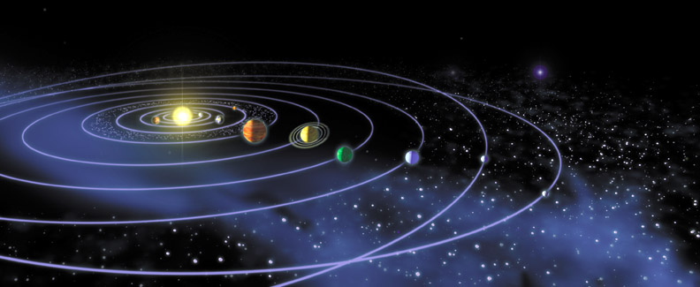
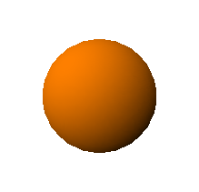
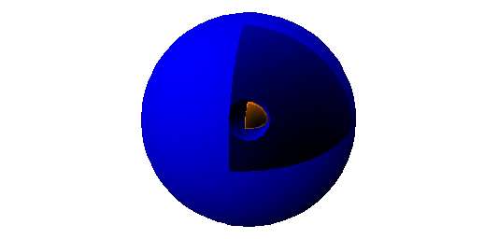
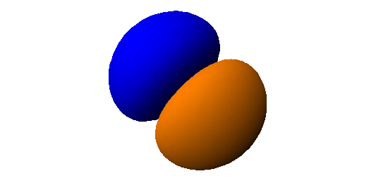
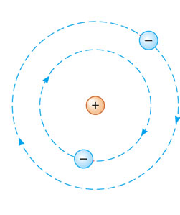
Solar system
Electronic orbit
s, p electron orbits
Orbital viewer

Slide 14
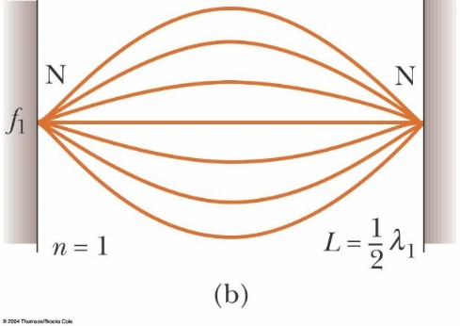
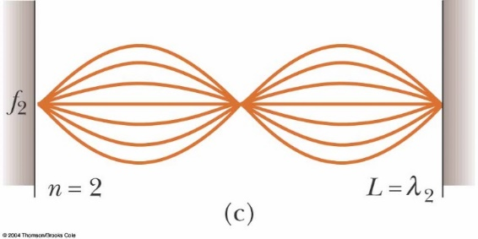
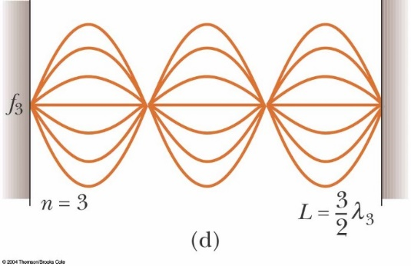
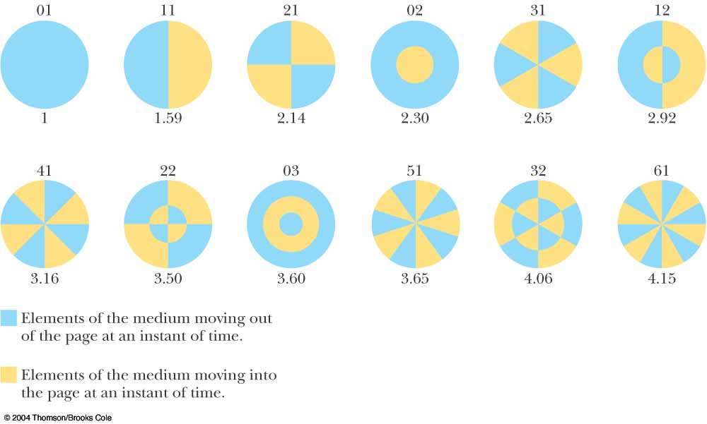
Resonance
One-dimensional
Two-dimensional
Three-dimensional
Hydrogen atom

Slide 15
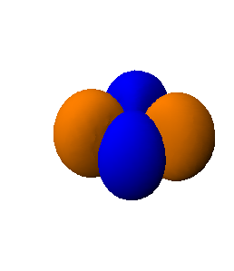
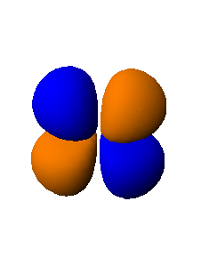
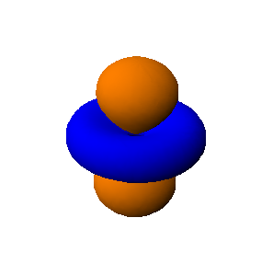
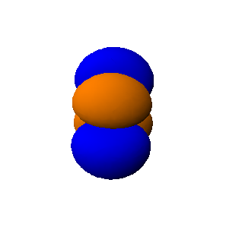
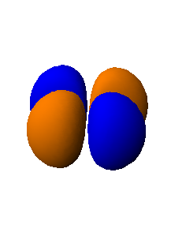
3d transition metals:
Mn atom has 5 d ↑ electrons Bulk Mn is NOT magnetic
s, p electron orbital
3d electron distribution in real space
Co atom has 5 d ↑electrons and 2 d ↓ electrons
Bulk Co is magnetic.
Orbital viewer

Slide 16
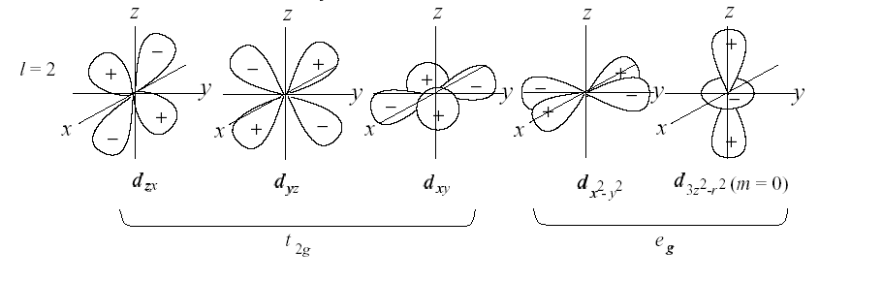
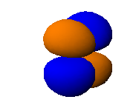
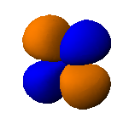
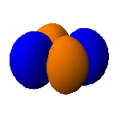
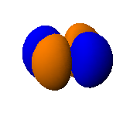
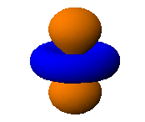
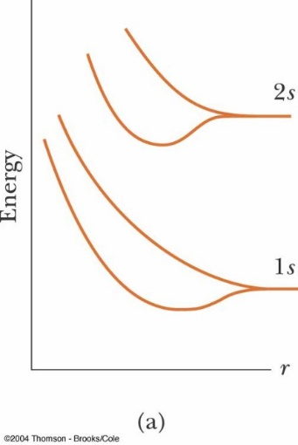
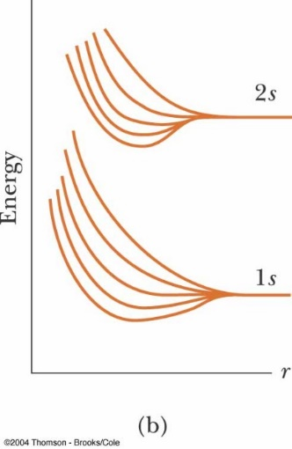
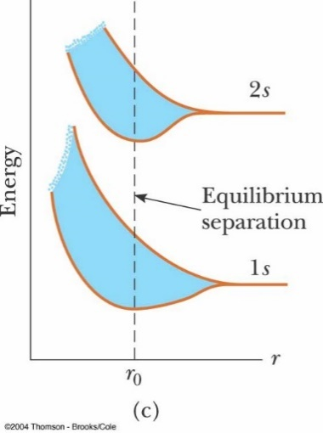

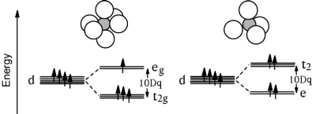
d orbitals
Crystal-field splitting

Slide 17
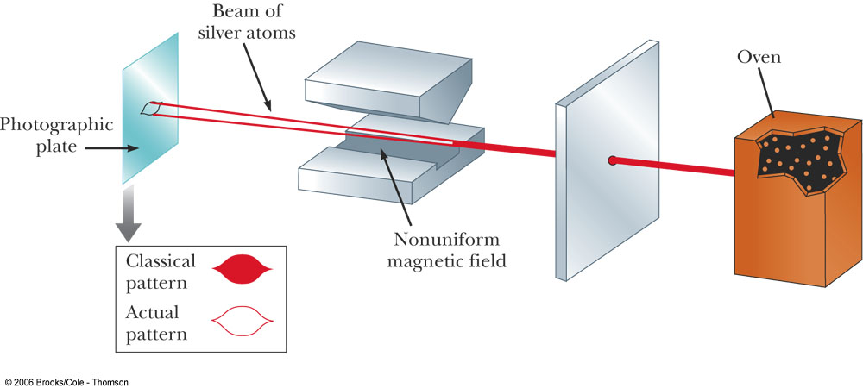
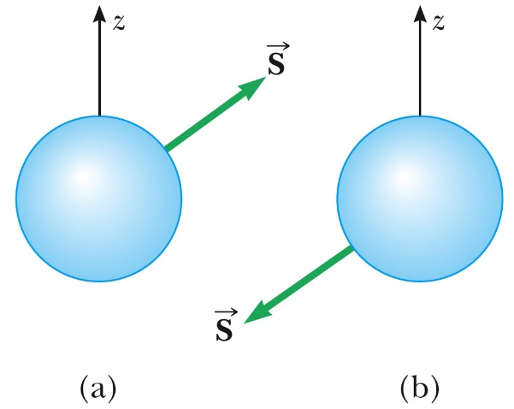
Stern-Gerlach Experiment
There are two kinds of electrons: spin-up and spin-down.
Stern and Gerlach: How a Bad Cigar Helped Reorient Atomic Physics
Physics Today 56, 53 (2003) 10.1063/1.1650229

Slide 18
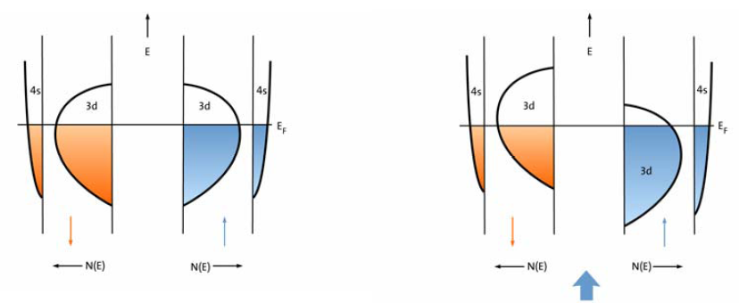
Stoner criterion for ferromagnetism:
I N(E_{F}) > 1, I is the Stoner exchange parameter and N(E_{F}) is the density of states at the Fermi energy.
For the non-magnetic state there are identical density of states for the two spins.
For a ferromagnetic state, N↑ > N↓. The polarization is indicated by the thick blue arrow.
Schematic plot for the energy band structure of 3d transition metals.
Teodorescu and Lungu, "Band ferromagnetism in systems of variable dimensionality". J Optoelectronics and Adv. Mat. 10, 3058–3068 (2008).

Slide 19
Stoner band ferromagnetism
Teodorescu, C. M.; Lungu, G. A. (November 2008). "Band ferromagnetism in systems of variable dimensionality". Journal of Optoelectronics and Advanced Materials 10 (11): 3058–3068.

Slide 20
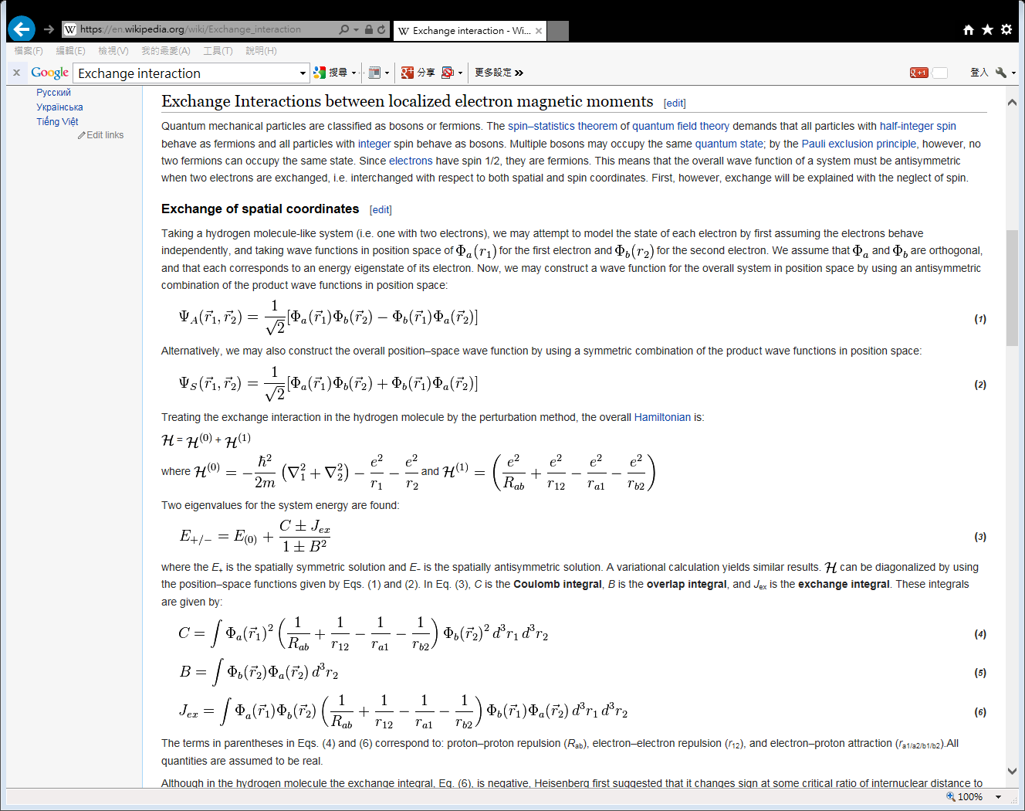
Exchange interaction

Slide 21
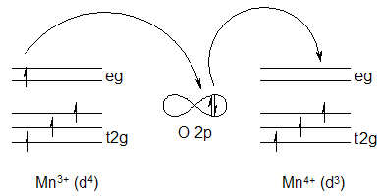
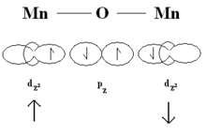
Double exchange interaction
Super exchange interaction
In superexchange, a ferromagnetic or antiferromagnetic alignment occurs between two atoms with the same valence (number of electrons) or differs by two, and the electrons are localized;
while in double-exchange, the interaction occurs only when one atom has an extra electron compared to the other, the electrons are itinerant (delocalized); this results in the material displaying magnetic exchange coupling, as well as metallic conductivity.

Slide 22
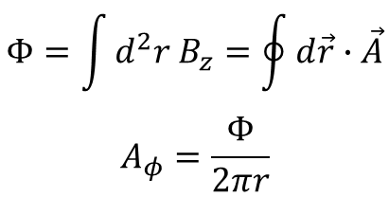
Berry Phase
Aharonov-Bohm Effect
Electron hologram showing interference fringes of electrons passing through small toroidal magnet. The magnetic flux passing through the torus is quantized so as to produce an integer multiple of π phase change in the electron wave functions. The electron is completely screened from the magnetic induction in the magnet. In (A) the phase change is 0, while in (B) the phase change is π. [Source: Tonomura (1993), p. 67.]
Electrons traveling around a flux tube suffer a phase change and can interfere with themselves even if they only travel through regions where B = 0.
(B) An open flux tube is not experimentally realizable, but a small toroidal magnet with no flux leakage can be constructed instead.
$$Φ=\int{d^{2}r B_{z}}=\oint{d\vec{r}∙\vec{A}}$$
$$A_{φ}=\frac{Φ}{2πr}$$

Slide 23
Parallel transport of a vector along a closed path on the sphere S2 leads to a geometric phase between initial and final state.
Real-space Berry phases: Skyrmion soccer (invited)
Karin Everschor-Sitte and Matthias Sitte
Journal of Applied Physics 115, 172602 (2014); doi: 10.1063/1.4870695

Slide 24
Berry phase formalism for
intrinsic Hall effects
From Prof. Guo Guang-Yu
Berry phase
[Berry, Proc. Roy. Soc. London A 392, 451 (1984)]
Parameter dependent system:
Adiabatic theorem:
Geometric phase:

Slide 25
Well defined for a closed path
From Prof. Guo Guang-Yu
Stokes theorem
Berry Curvature

Slide 26
Analogies
From Prof. Guo Guang-Yu
Berry curvature
Magnetic field
Berry connection
Vector potential
Geometric phase
Aharonov-Bohm phase
Chern number
Dirac monopole

Slide 27
Semiclassical dynamics of Bloch electrons
Old version [e.g., Aschroft, Mermin, 1976]
From Prof. Guo Guang-Yu
New version [Marder, 2000]
Berry phase correction [Chang & Niu, PRL (1995), PRB (1996)]
(Berry curvature)

Slide 28
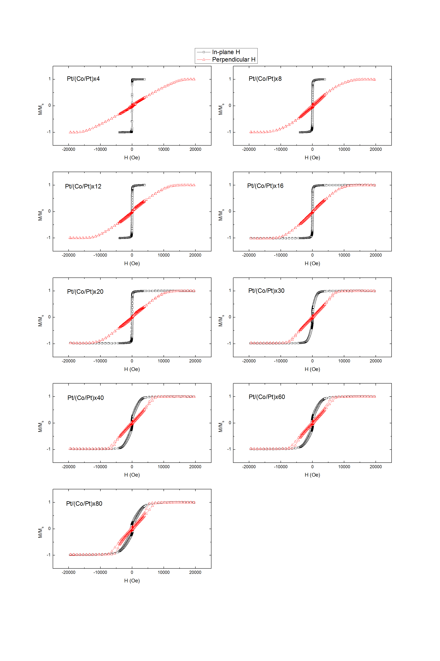



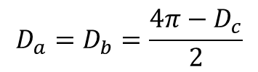
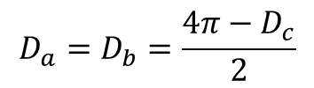



Demagnetization factor D
can be solved analytically in some cases, numerically in others
For an ellipsoid D_{x} + D_{y} + D_{z} = 1 (SI units) D_{x} + D_{y} + D_{z} = 4π (cgs units)
Solution for Spheroid a = b ≠ c
Prolate spheroid (football shape) c/a = r > 1 ; a = b , In cgs units
Limiting case r >> 1 ( long rod )
Oblate Spheroid (pancake shape) c/a = r < 1 ; a = b
Limiting case r >> 1 ( flat disk)
$$D_{c}=\frac{4π}{r^{2}−1} \left[\frac{r}{\sqrt{r^{2}−1}}\ln\left(r+\sqrt{r^{2}−1}\right)−1\right]$$
a
$$D_{a}=D_{b}=\frac{4π−D_{c}}{2}$$
a
c
$$D_{c}=\frac{4π}{r^{2}} \left[\ln\left(2r\right)−1\right]≪1$$
Note: you measure 2πM
without knowing the sample
$$D_{a}=D_{b}=2π$$
$$D_{c}=\frac{4π}{{1−r}^{2}} \left[1−\frac{r}{\sqrt{{1−r}^{2}}}\cos^{−1}{r}\right]$$
$$D_{a}=D_{b}=\frac{4π−D_{c}}{2}$$
$$D_{c}=4π$$
Note: you measure 4πM
without knowing the sample
$$D_{a}=D_{b}={π }^{2}r≪1$$

Slide 29
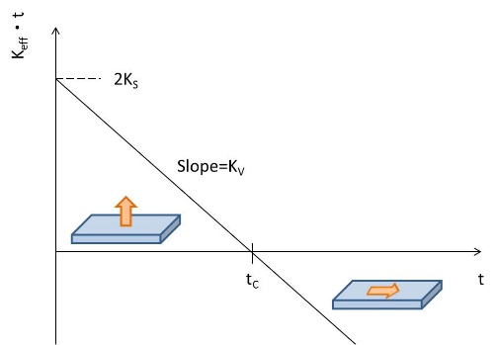
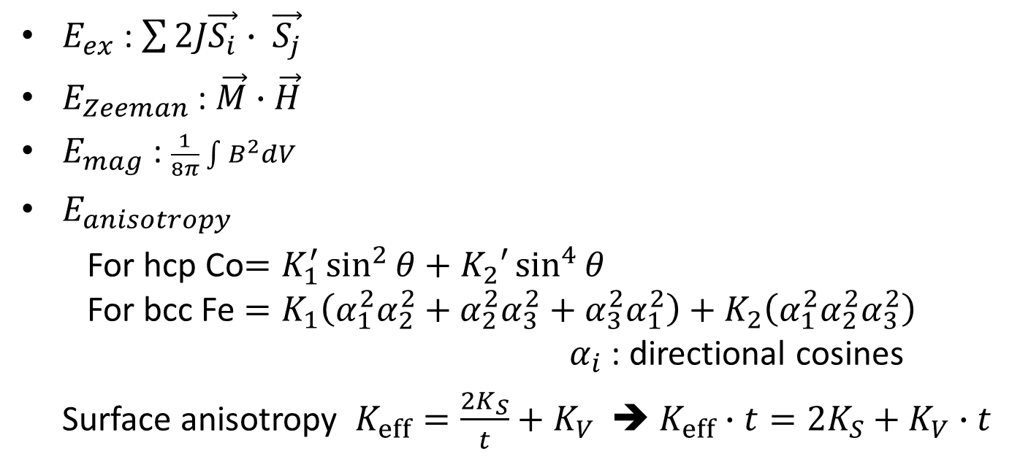
Surface anisotropy
$$E=E_{exchange}+E_{Zeeman}+E_{mag}+E_{anisotropy}+…$$
$E_{ex}$ : $\sum{2J\vec{S_{i}}∙ \vec{S_{j}}}$
$E_{Zeeman}$ : $\vec{M}∙\vec{H}$
$E_{mag}$ : $\frac{1}{8π}\int{B^{2}dV}$
$E_{anisotropy}$
For hcp Co$=K_{1}^{′}\sin^{2}{θ}+K_{2}′\sin^{4}{θ}$
For bcc Fe $=K_{1}\left(α_{1}^{2}α_{2}^{2}+α_{2}^{2}α_{3}^{2}+α_{3}^{2}α_{1}^{2}\right)+K_{2}\left(α_{1}^{2}α_{2}^{2}α_{3}^{2}\right)$
$α_{i}$ : directional cosines
Surface anisotropy $K_{eff}=\frac{2K_{S}}{t}+K_{V}$ ➔ $K_{eff}∙t=2K_{S}+K_{V}∙t$

Slide 30
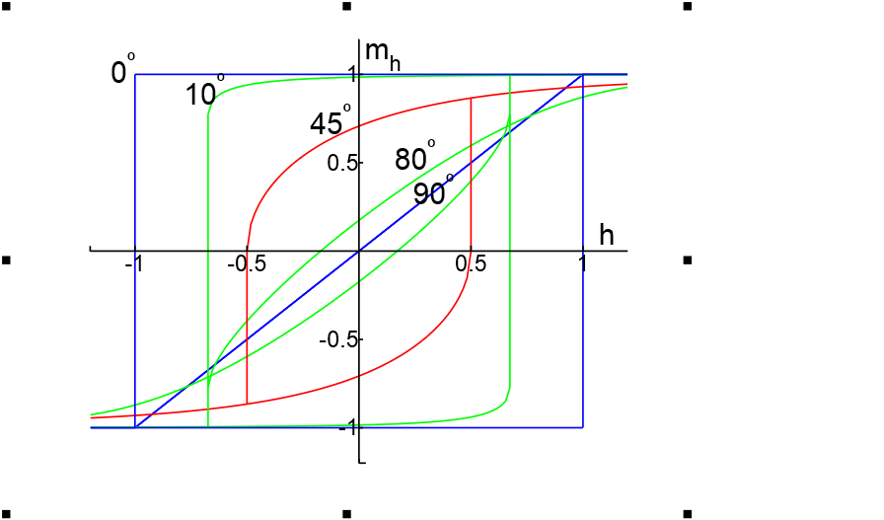
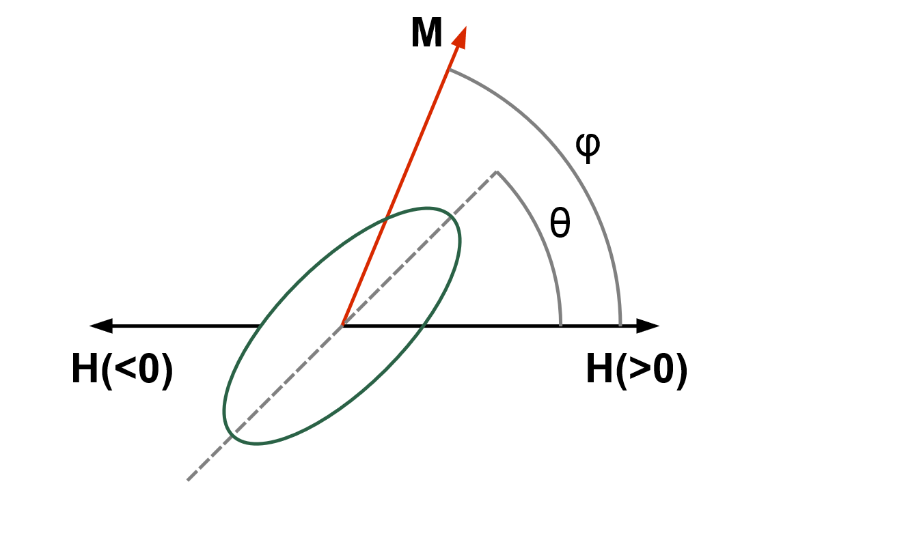
Stoner–Wohlfarth model
A widely used model for the magnetization of single-domain ferromagnets. It is a simple example of magnetic hysteresis and is useful for modeling small magnetic particles
where K_{u} is the uniaxial anisotropy parameter, V is the volume of the magnet, M_{s} is the saturation magnetization.

Slide 31
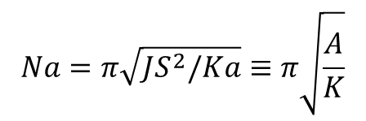

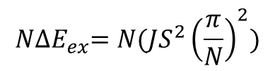




Ferromagnetic domains
  competition between exchange, anisotropy, and magnetic energies.
  Bloch wall: rotation out of the plane of the two spins
  Neel wall: rotation within the plane of the two spins
For a 180° Bloch wall rotated in N+1 atomic planes
$$N{∆E}_{ex}=N(JS^{2}{\left(\frac{π}{N}\right)}^{2})$$
Wall energy density
$$σ_{w}=σ_{ex}+σ_{anis}≈JS^{2}π^{2}/{(Na}^{2})+KNa$$
$a$ : lattice constant
${∂σ}_{w}/∂N≡0$,
$$N=\sqrt{[JS^{2}π^{2}/{(Ka}^{3})]}≈300$$
in Fe
$$σ_{w}=2π\sqrt{KJS^{2}/a}≈$$
1 erg/cm² in Fe
$$Na=π\sqrt{JS^{2}/Ka}≡π\sqrt{\frac{A}{K}}$$
Wall width
,
$A=$ $JS^{2}/a$
Exchange stiffness constant

Slide 32
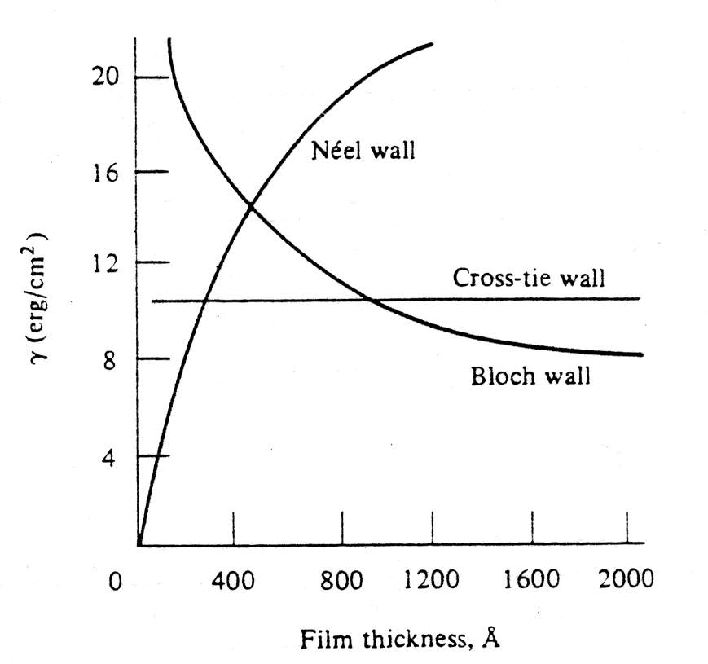
Domain wall energy γ versus thickness D of Ni₈₀Fe₂₀ thin films
D ∼ 50nm
γ_{N}
γ_{N} < γ_{B} ~ 50nm
Thick films have Bloch walls Thin films have Neel walls
Cross-tie walls show up in between.
A=10⁻⁶ erg/cm
K=1500 erg/cm³
γ_{N} < γ_{B}
γ_{B}
Cross-tie zone
D
Further reference: Antonio DeSimone, Hans Knupfer, and Felix Otto, Calculus of Variations 27, 233–253 (2006) 2-d stability of the Neel wall

Slide 33
Magnetic Resonance
Nuclear Magnetic Resonance (NMR)
  Line width
  Hyperfine Splitting, Knight Shift
  Nuclear Quadrupole Resonance (NQR)
Ferromagnetic Resonance (FMR)
  Shape Effect
  Spin Wave resonance (SWR)
Antiferromagnetic Resonance (AFMR)
Electron Paramagnetic Resonance (EPR or ESR)
  Exchange narrowing
  Zero-field Splitting
Maser
What we can learn:
From absorption fine structure ➔ electronic structure of single defects
From changes in linewidth ➔ relative motion of the spin to the surroundings
From resonance frequency ➔ internal magnetic field
Collective spin excitations

Slide 34












FMR
Equation of motion of a magnetic moment$μ$ in an external field $B_{0}$
$$\frac{ℏdI}{dt}=μ×B$$
$$μ=γℏI$$
$$\frac{dμ}{dt}=γμ×B$$
$$\frac{dM}{dt}=γM×B$$
Landau-Lifshitz-Gilbert (LLG) equation
Shape effect:
internal magnetic field
$$\frac{dM}{dt}=−γM×H_{eff}+αM×\frac{dM}{dt}$$
$$B_{x}^{i}=B_{x}^{0}−N_{x}M_{x}$$
$$B_{y}^{i}=B_{y}^{0}−N_{y}M_{y}$$
$$B_{z}^{i}=B_{z}^{0}−N_{z}M_{z}$$
$$\frac{dM_{x}}{dt}=γ\left(M_{y}B_{z}^{i}−M_{z}B_{y}^{i}\right)=γ[B_{0}+\left(N_{y}−N_{z}\right)M]M_{y}$$
$$\frac{dM_{y}}{dt}=γ\left[M\left({−N}_{x}M_{x}\right)−M_{x}\left(B_{0}−N_{z}M\right)\right]=−γ[B_{0}+\left(N_{x}−N_{z}\right)M]M_{x}$$
To first order
$$\frac{dM_{z}}{dt}=0$$
$M_{z}$= $M$
$$\left|\begin{matrix}iω & γ[B_{0}+\left(N_{y}−N_{z}\right)M] \\ −γ[B_{0}+\left(N_{x}−N_{z}\right)M] & iω\end{matrix}\right|=0$$
$$ω_{0}^{2}=γ^{2}[B_{0}+\left(N_{y}−N_{z}\right)M][B_{0}+\left(N_{x}−N_{z}\right)M]$$
Uniform mode

Slide 35













Sphere flat plate with perpendicular field flat plate with in-plane field
Uniform mode
B₀
B₀
$${N_{x}=N}_{y}=N_{z}$$
$${N_{x}=N}_{y}=0$$
$$N_{z}=4π$$
$${N_{x}=N}_{z}=0$$
$$N_{y}=4π$$
$$ω_{0}=γ B_{0}$$
$$ω_{0}=γ {(B}_{0}−4πM)$$
$$ω_{0}=γ {{[B}_{0}(B_{0}+4πM)]}^{1/2}$$
Spin wave resonance; Magnons
Consider a one-dimensional spin chain with only nearest-neighbor interactions.
$$U=−2J\sum{\vec{S_{i}}∙ \vec{S_{j}}}$$
We can derive
$$ℏω=4JS(1−\cos{ka})$$
When ka << 1
$$ℏω≅(2JSa^{2})k^{2}$$
flat plate with perpendicular field
$$ω_{0}=γ {(B}_{0}−4πM)+Dk^{2}$$
Quantization of (uniform mode) spin waves, then consider the thermal excitation of Mannons, leads to Bloch T^{3/2} law.
$$∆M/M(0)∝T^{3/2}$$

Slide 36














AFMR
Spin wave resonance; Antiferromagnetic Magnons
Consider a one-dimensional antiferromangetic spin chain with only nearest-neighbor interactions. Treat sublattice A with up spin S and sublattice B with down spin –S, J<0.
$$U=−2J\sum{\vec{S_{i}}∙ \vec{S_{j}}}$$
We can derive
$$ℏω=−4JS|\sin{ka}|$$
When ka << 1
$$ℏω≅(−4JS)|ka|$$
AFMR
exchange plus anisotropy fields on the two sublattices
$$B_{1}=−λM_{2}+B_{A}\hat{z}$$
on M₁
$$B_{2}=−λM_{1}−B_{A}\hat{z}$$
on M₂
$$M_{1}^{z}≡M$$
$$M_{2}^{z}≡−M$$
$$M_{1}^{+}≡M_{1}^{x}+iM_{1}^{y}$$
$$M_{2}^{+}≡M_{2}^{x}+iM_{2}^{y}$$
$$B_{E}≡λM$$
$$\frac{dM_{1}^{+}}{dt}=−iγ[M_{1}^{+}\left(B_{A}+B_{E}\right)+M_{2}^{+}B_{E}]$$
$$\frac{dM_{2}^{+}}{dt}=−iγ[M_{2}^{+}\left(B_{A}+B_{E}\right)+M_{1}^{+}B_{E}]$$
$$\left|\begin{matrix}γ\left(B_{A}+B_{E}\right)−ω & γB_{E} \\ B_{E} & γ\left(B_{A}+B_{E}\right)+ω\end{matrix}\right|=0$$
$$ω_{0}^{2}=γ^{2}B_{A}\left(B_{A}+{2B}_{E}\right)$$
Uniform mode

Slide 37
Spintronics
Electronics with electron spin as an extra degree of freedom
Generate, inject, process, and detect spin currents
Generation: ferromagnetic materials, spin Hall effect, spin pumping effect etc.
Injection: interfaces, heterogeneous structures, tunnel junctions
Process: spin transfer torque
Detection: Giant Magnetoresistance, Tunneling MR
Historically, from magnetic coupling to transport phenomena
important materials: CoFe, CoFeB, Cu, Ru, IrMn, PtMn, MgO, Al2O3, Pt, Ta

Slide 38


Spin Transfer Torque
S
≈ 0.1 μm
F₁ F₂
Transverse component
S
The transverse spin component is lost by the conduction electrons, transferred to the global spin of the layer
S
Tsoi et al. PRL 61, 2472 (1998)
Slonczewski JMMM 159, L1 (1996)
Modified Landau-Lifshitz-Gilbert
(LLG) equation
Experimantally determined current density ~10¹⁰-10¹²A/m²

Slide 39
Spin Transfer Torque
e⁻
when there is a saturation field, magnetization precession radiates microwave.
e⁻
In a trilayer, current direction determines the relative orientation of F1 and F2 when H = 0

Slide 40


Spin Transfer Torque
Landau-Lifshitz-Gilbert equation with Spin Transfer Torque terms
Current induced domain wall motion
Passing spin polarized current from Domain A to Domain B$⇒$B switches
e⁻
e⁻
Berger, JAP 55, 1954 (1984)
Tatara et. al., PRL 92, 086601 (2004)
Zhang et. al., PRL 93, 127204 (2004)
Thiaville et. al., Europhys. Lett. 69, 990 (2005)
Stiles et. al., PRB 75, 214423 (2007)

Slide 41

Spin Transfer Torque
Landau-Lifshitz-Gilbert equation with Spin Transfer Torque terms
$${\frac{∂\vec{M}}{∂t}=−γ\vec{M}×{\vec{H}}_{\text{eff}}+\frac{α}{M_{s}}\vec{M}×\frac{∂\vec{M}}{∂t}−\frac{b_{j}}{M_{s}^{2}}\vec{M}×(\vec{M}×\frac{∂\vec{M}}{∂x})−\frac{c_{j}}{M_{s}}\vec{M}×\frac{∂\vec{M}}{∂x} b}_{j},c_{j} \sim JP/t$$
In-plane torque
Anti-damping
Destabilizes M
H_{oop}
Out-of-plane torque
Field-like torque
Modifies energy barrier

Slide 42





Industrial applications
Read head in hard drives
MRAM

Slide 43

Magnetic skyrmions
Neel
Bloch
How to generate
To detect
To manipulate
Magnetic field
Electric current
Spin current, spin wave

